Slide 1
4th Grade Curriculum Night
8.23.18
Welcome Back
To School!

Slide 2
Meet
The
Team

Slide 3
Grading Policy
Language Arts, Math, Science, SS:
Tests/Projects – 30%
Classwork/Quizzes – 70%
Tests – Can be retaken/corrected after reteaching for
A 70.
15 points will be deducted each day classwork is late (after 5 days).

Slide 4
2018-2019 4th Grade Schedule
8:00-10:15 Block 1 (Homeroom)
10:45-11:15 Recess
11:15-11:45 Lunch
10:15-1:40 Block 2
1:40-2:40 Enrichment
2:40-3:20 WIN
3:25 Dismissal

Slide 5
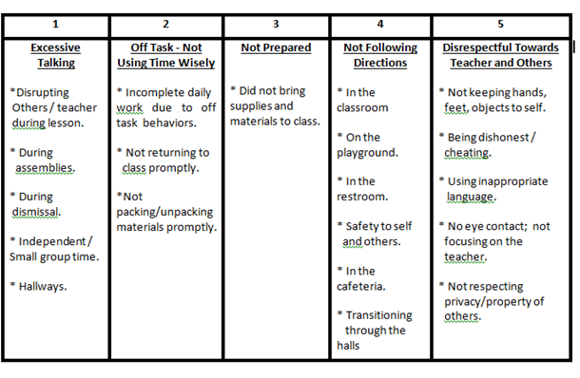
Conduct

Slide 6
Consequences & Rewards
Consequences:
Students will complete a Behavior Reflection Form during Study Hall if behavior does not meet 4th grade expectations.
Teacher reserves the right to provide immediate consequence based on behavior.
During lunch if student is talking during “light out” time then they will be given lonely lunch the following day.
Rewards:
ROC recess Dojo Points Parent Contact
Class rewards Homework Passes House Tickets

Slide 7
ROC
Responsible Organized Citizen
ROC recess every 3 weeks for students who don’t have more than 2 entries

Slide 8
Homework
Math Tuesdays, due on Friday.
Language Arts Mondays & Wednesdays
Late Policy - Homework is due the next day after it is assigned by the teacher. Five points will be deducted from the student’s six weeks homework grade every time homework is turned in late.
Math Facts/ Vocab. words will need to be practiced during the week.

Slide 9
Math
TEKS based curriculum Technology:
Motivation Math Ed. Galaxy
Daily Problem Solving
Whole Group, Guided, stations
Gather from several sources
CBAs from district
Target the Question

Slide 10
Language Arts
Word Studies
Mentoring Minds Motivation Reading
Write Source Skills/Reading Blue Book
Editing and Revising
Empowering Writers
iStation - once a week
Vocabulary Quizzes on Fridays

Slide 11
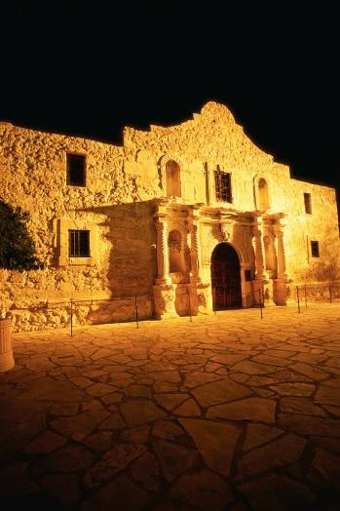
Science & Social Studies Focus
Social Studies:
Texas History
Science:
STEMScopes-online
TEKS-Based

Slide 12
Curriculum
You can access MISD curriculum by doing the following:
MISD home page
Departments
Curriculum & Instruction
Choose subject then grade level

Slide 13
Communication
Communicator
Email
Skyward
Online 4th Grade Newsletter:
www.daulton4.weebly.com
Phone 817-299-6640
Remind

Slide 14
REMIND Messages
If you are not signed up for your child’s homeroom teacher’s Remind messaging- Then check with them to get registered tonight.

Slide 15
Important Reminders
All papers with a grade less than 70 must be corrected and returned signed (CARS). Grade does not change.
Students are expected to be in their seats, READY by 8:00.
Please log on to Skyward at least once a week to view your child’s grades and missing assignments.
Please do not remove graded papers from the binder. They will
be removed at the end of each six weeks.
Late policy for classwork- each day, after 5 days, classwork is late, 15 points will be deducted

Slide 16
4th Grade Field Trip
When: Our field trip date is Wednesday, March 27th.· Where: Inner Space Caverns and Waco Mammoth National Monument.· Price: $93.00. We will have fundraisers to help reduce this cost.
**First Fundraiser is at Mooyah Burgers on Tuesday, September 25th.

Slide 17
Volunteers
Because the safety of our students and staff is our top priority, those wanting to become MISD volunteers must go through the following security measures before serving in the district:
Volunteers must provide a driver’s license or another form of identification containing the person’s photograph issued by an entity of the U.S. government to verify identity on or before the day that volunteering occurs. This allows us to print a sticker badge for you to wear within the building.
Volunteers must pass a criminal background check. The form can be found online or through the email you received from your child’s teacher. If you already completed this online form this year for another campus, you do not need to do another. Once you are in the system for this year, it applies to all MISD campuses.
Anyone who supervises or is around students during a school-sponsored event (ie – class parties, field trips, Field Day) is considered a volunteer. Lunch visitors do not have to complete the background check, but they are required to provide photo ID at the front office upon arrival.
Must complete background check annually.
Thanks for your support and partnership in your child’s education!

Slide 18
Birthday
Treats
Procedures / Requirements:
- Store Purchase Only (with ingredient label, if possible – some stores don’t necessarily have labels.) (Parent)
- Give Teacher 3 Days notice of item to class (Parent)
- Give office staff (Mrs. Shaw) immediate notification via email after you approved the date items are arriving (Classroom Teacher)
- Read Label (Nurse, if possible)
- Ensure possible Food Allergies of students in class (Classroom Teacher)
- Notify parents in the class that cupcakes (or a treat) are arriving on such a day, and if they do not want their child to have one, to please email you immediately. In addition, suggesting that they provide an extra/alternative snack during that time for their child is encouraged (Classroom Teacher)
- Consumed after lunch or at the end of the day before dismissal (Classroom Teacher)

Slide 19
Questions?

